Slide 1
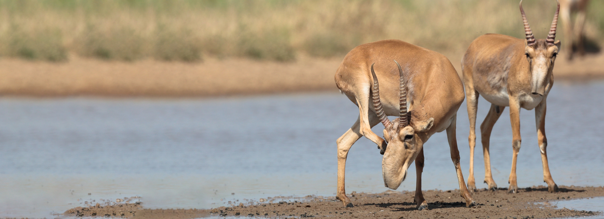


Convention on Migratory Species
The Fourth Meeting of Signatories to the Saiga MOU
28-29 September 2021, Russian Federation, online meeting
CONSERVATION STATUS AND MOU IMPLEMENTATION: OVERVIEW
B. Buuveibaatar, Wildlife Conservation Society / Saiga Conservation Alliance

Slide 2
Global range
Saiga tatarica
Saiga borealis

Slide 3
Population size in 2021
Russia: 10,000 Kazakhstan: 842,000
Uzbekistan: 150-200 Turkmenistan: No saiga observed last 20 years
Mongolia: 8,451 Overall: 860,451saiga
Population | 2006 | 2010 | 2015 | 2021 | Trend in 2020
NW Pre-Caspian[RU] | 15,000-20,000 | 10,000-20,000 | 4,500-5,000 | 10,000 | Increasing
Ural [KZ, RU] | 12,900 | 27,140 | 51,700 | 545,000 | Increasing
Ustyurt [KZ, TM, UZ] | 17,800 | 4,900 | 1,270 | 12,000 | Increasing
Betpak-dala [KZ] | 18,300 | 53,440 | 31,300 | 285,000 | Increasing
Mongolia [MN] | 3,169 | 8,016 ± 1,656 | 14,869 | 8,451 | Increasing
Total | 67,169-72,169 | 103,496-113,496 | 103,639-104,139 | 860,451 | Increasing
Saiga population has increased in abundance across its range since 2015
Notes:
IOSEA Marine Turtle MOU
Sub regional meetings of the Marine Turtle Task Forces are instrumental in the implementation of the MOU.
Two of the 4 MTTFs met in 2017 and 2018. The report for the NIO is available online
CITES Secretariat in close cooperation with CMS IOSEA secretariat and Advisory Committee compiled and analyzed data on legal and illegal trade international and domestic trade in marine turtles. The process was supported by implementing agencies, such as TRAFFIC and WWF with the financial support from Australia via CMS. The preliminary report is available online
Final report should be available on November 23rd 2018.
Dugong MOU – IKI project
Continuing to revise IKI project based on feedback.
Don’t anticipate any major revisions.
Hope to have submitted to BMU for final approval before the end of this year.

Slide 4
Threats
 | Nil | Low | Medium | High | Very high | Unknown
Illegal hunting for meat | Mongolia | Kazakhstan | Russia |  | Uzbekistan
Illegal hunting for horns/trade |  |  | Uzbekistan | Russia, Mongolia, Kazakhstan
Habitat loss |  | Uzbekistan, Kazakhstan | Russia | Russia, Mongolia
Livestock competition |  | Uzbekistan | Russia, Kazakhstan | Mongolia
Disease | Uzbekistan |  | Russia, Kazakhstan | Russia, Mongolia
Climate |  |  | Kazakhstan | Uzbekistan, Russia, Mongolia
Predation |  | Uzbekistan, Mongolia, Kazakhstan | Russia
Fragmentation |  |  | Uzbekistan, Russia, Kazakhstan | Mongolia
Demographic factors |  | Mongolia | Russia, Kazakhstan |  |  | Uzbekistan
Barriers to migration |  |  | Russia, Kazakhstan | Russia, Mongolia | Uzbekistan
Other |  | Russia | Russia, Mongolia

Slide 5
Major concerns
Population sizes are still too low in three populations
Poaching and trade in Saiga products is still happening
Demand for Saiga products in consumer countries is still high
Monitoring of trends in abundance is still inconsistent
Linear infrastructure are impacting (particularly Ustyurt and Betpak-dala)
Mass mortality from disease is still an issue
Conservation-focussed captive breeding facilities are not well organised
Increasing threat of resentment of Saigas by local livestock herders, increasing competition for grazing and water
The impacts of climate change on Saigas could be severe but are still poorly understood
More substantial funding is required from international donors and from national governments

Slide 6
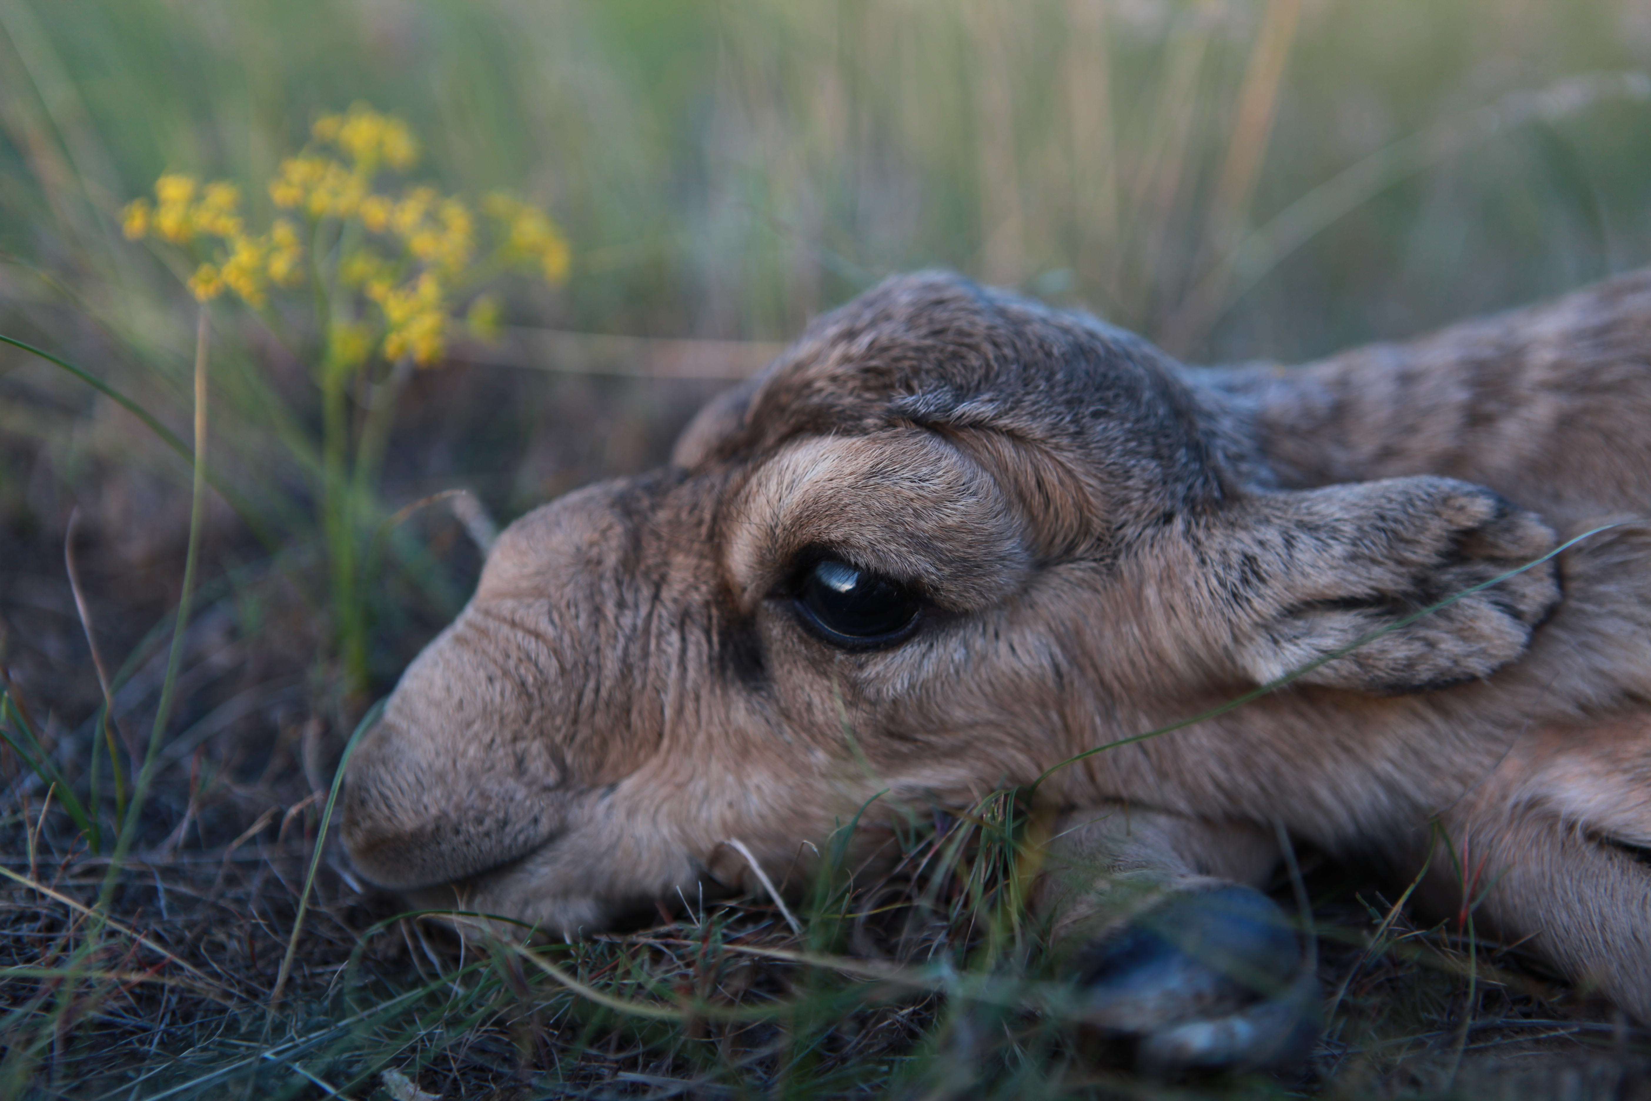
THANK YOU
Insert Image

