Slide 1
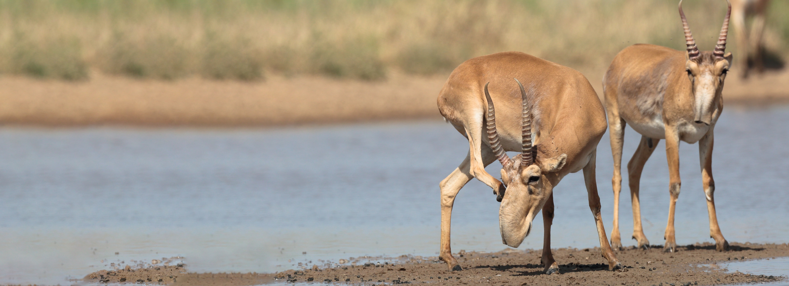


Convention on Migratory Species
The Fourth Meeting of Signatories to the Saiga MOU
28-29 September 2021, Russian Federation, online meeting
Tom De Meulenaer
Chief, Science Unit,
CITES Secretariat

Slide 2
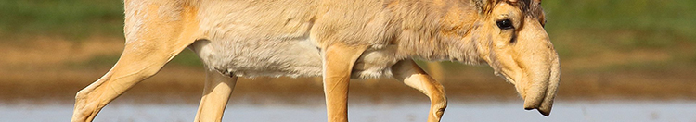
Saiga-relevant developments at CITES since 2015 Document UNEP/CMS/Saiga/MOS4/Inf.12

Slide 3
CITES Appendix II listing
Saiga tatarica and Saiga borealis included in CITES Appendix II since 1995
CoP18, Geneva, 2019:
CoP18 Prop. 2 (Mongolia and the United States of America): transfer of Saiga tatarica to Appendix I
CoP did not support proposal, but agreed to amend listings in Appendix II by adopting an annotation for S. tatarica and S. borealis:
‘A zero export quota for wild specimens traded for commercial purposes’
New annotation entered into effect on 26 November 2019
Notes:
Saiga tatarica and Saiga borealis have been included in CITES Appendix II since 1995.
2. At the 18th meeting of the Conference of the Parties (CoP18, Geneva, 2019), it was agreed to amend the listing of both species in Appendix II by adding the following annotation: “A zero export quota for wild specimens traded for commercial purposes”. These amendments were based on discussions of CoP18 Prop. 2, submitted by Mongolia and the United States of America, proposing to transfer Saiga tatarica from Appendix II to Appendix I. The Secretariat published a technical evaluation of this proposal for CoP18.
See https://cites.org/sites/default/files/eng/cop/18/prop/060319/E-CoP18-Prop-02.pdf
See https://cites.org/sites/default/files/eng/cop/18/doc/E-CoP18-105-01-A2.pdf

Slide 4
Implications of new annotations: summary
Range States cannot export saiga specimens of wild origin [source code W] for commercial purposes [purpose code T]
E.g. commercial shipments of horns, live animals, bones, skulls, meat or hides
Range States can export saiga specimens of wild origin [source code W] for non-commercial purposes
E.g. trophies, live animals for zoos or reintroduction, scientific or judicial samples, research, educational exchanges, personal effects
Range States and Parties can export saiga specimens for commercial or non-commercial purposes if they come from captive bred animals [source code C or F] or are pre-Convention [source code O]
Range States and Parties can re-export saiga specimens
Notes:
Saiga tatarica and Saiga borealis have been included in CITES Appendix II since 1995.
2. At the 18th meeting of the Conference of the Parties (CoP18, Geneva, 2019), it was agreed to amend the listing of both species in Appendix II by adding the following annotation: “A zero export quota for wild specimens traded for commercial purposes”. These amendments were based on discussions of CoP18 Prop. 2, submitted by Mongolia and the United States of America, proposing to transfer Saiga tatarica from Appendix II to Appendix I. The Secretariat published a technical evaluation of this proposal for CoP18.
See https://cites.org/sites/default/files/eng/cop/18/prop/060319/E-CoP18-Prop-02.pdf
See https://cites.org/sites/default/files/eng/cop/18/doc/E-CoP18-105-01-A2.pdf

Slide 5
Saiga decisions and reporting
Dedicated saiga decisions were adopted by CITES Parties at CoP13 [Bangkok, 2004], CoP14 [The Hague, 2007], CoP15 [Doha, 2010], CoP16 [Bangkok, 2013], CoP17 [Johannesburg, 2016] and CoP18 [Geneva, 2019]
Decisions 18.270 to 18.274 currently in effect [see Annex 1 of UNEP/CMS/Saiga/MOS4/Inf.12]
Directed to: Saiga antelope range States and major saiga trading and consumer States; the CITES and CMS Secretariats
Progress reports on implementation to CoP, Standing Committee and Animals Committee
Most recent: SC70 [Sochi, 2018], CoP18 [Geneva, 2019], and AC31 [online, June 2021]
Notes:
Saiga tatarica and Saiga borealis have been included in CITES Appendix II since 1995.
2. At the 18th meeting of the Conference of the Parties (CoP18, Geneva, 2019), it was agreed to amend the listing of both species in Appendix II by adding the following annotation: “A zero export quota for wild specimens traded for commercial purposes”. These amendments were based on discussions of CoP18 Prop. 2, submitted by Mongolia and the United States of America, proposing to transfer Saiga tatarica from Appendix II to Appendix I. The Secretariat published a technical evaluation of this proposal for CoP18.
See https://cites.org/sites/default/files/eng/cop/18/prop/060319/E-CoP18-Prop-02.pdf
See https://cites.org/sites/default/files/eng/cop/18/doc/E-CoP18-105-01-A2.pdf

Slide 6
Next reporting and new CITES saiga decisions
Next CITES reporting and discussions:
SC74, Lyon, March 2022 [reporting to Standing Committee by Secretariat and AC]
CoP19, Panama City, November 2022 [documents and amendment proposals must be submitted by 17 June 2022]
AC31: Proposes renewal and update of Decisions 18.270 to 18.274 to the Standing Committee for onward submission to CoP19 [see Annex 2 of UNEP/CMS/Saiga/MOS4/Inf.12]
AC31: United States of America committed funding [40,000 USD] for the implementation by the CITES Secretariat of Decision 18.271, paragraph d), concerning management of saiga horn stockpiles. Implementation in 2022. Other activities mentioned in the Decision remain unfunded.
Notes:
Saiga tatarica and Saiga borealis have been included in CITES Appendix II since 1995.
2. At the 18th meeting of the Conference of the Parties (CoP18, Geneva, 2019), it was agreed to amend the listing of both species in Appendix II by adding the following annotation: “A zero export quota for wild specimens traded for commercial purposes”. These amendments were based on discussions of CoP18 Prop. 2, submitted by Mongolia and the United States of America, proposing to transfer Saiga tatarica from Appendix II to Appendix I. The Secretariat published a technical evaluation of this proposal for CoP18.
See https://cites.org/sites/default/files/eng/cop/18/prop/060319/E-CoP18-Prop-02.pdf
See https://cites.org/sites/default/files/eng/cop/18/doc/E-CoP18-105-01-A2.pdf

Slide 7
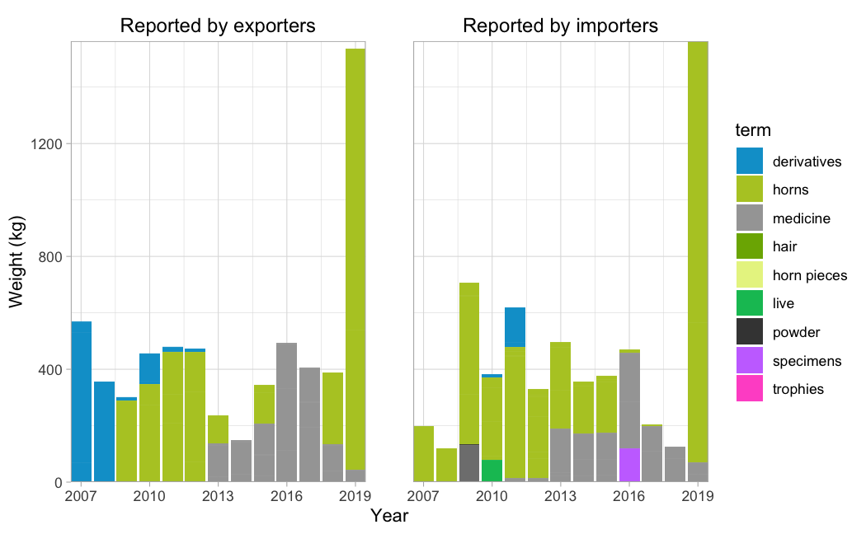
CITES trade in Saiga spp. 2007-2019: volumes
Reporting on relatively low volumes of trade; few cases of illegal trade
2010-18 annual averages:
~250 kg of horn per year
~250/300 kg of medicines per year
2019 > 4,500 kg of horn traded
3,135 kg re-exported from Singapore to Hong Kong SAR [W; Origin Kazakhstan]
1,494 kg from Ukraine to China [pre-convention and unknown origins]
Direct trade in S. tatarica parts and derivatives by term, reported by weight, 2007-2019 (all sources excluding ‘I’, all purposes)
Notes:
Saiga tatarica and Saiga borealis have been included in CITES Appendix II since 1995.
2. At the 18th meeting of the Conference of the Parties (CoP18, Geneva, 2019), it was agreed to amend the listing of both species in Appendix II by adding the following annotation: “A zero export quota for wild specimens traded for commercial purposes”. These amendments were based on discussions of CoP18 Prop. 2, submitted by Mongolia and the United States of America, proposing to transfer Saiga tatarica from Appendix II to Appendix I. The Secretariat published a technical evaluation of this proposal for CoP18.
See https://cites.org/sites/default/files/eng/cop/18/prop/060319/E-CoP18-Prop-02.pdf
See https://cites.org/sites/default/files/eng/cop/18/doc/E-CoP18-105-01-A2.pdf

Slide 8
CITES trade in Saiga spp. 2007-2019: trade routes
Main direct exporters: China, Ukraine. Lesser extent Japan, Hong Kong SAR, Singapore
Main direct importers: Japan, China. Lesser extent Hong Kong SAR, Malaysia, Singapore
Main re-exporter: Singapore [horn from Kazakhstan, Russia and Unknown origins] to Hong Kong SAR (>80%) and Japan (15%)
Notes:
Saiga tatarica and Saiga borealis have been included in CITES Appendix II since 1995.
2. At the 18th meeting of the Conference of the Parties (CoP18, Geneva, 2019), it was agreed to amend the listing of both species in Appendix II by adding the following annotation: “A zero export quota for wild specimens traded for commercial purposes”. These amendments were based on discussions of CoP18 Prop. 2, submitted by Mongolia and the United States of America, proposing to transfer Saiga tatarica from Appendix II to Appendix I. The Secretariat published a technical evaluation of this proposal for CoP18.
See https://cites.org/sites/default/files/eng/cop/18/prop/060319/E-CoP18-Prop-02.pdf
See https://cites.org/sites/default/files/eng/cop/18/doc/E-CoP18-105-01-A2.pdf

Slide 9
CITES Secretariat activities re. Saiga spp.
Activities with CMS Secretariat
MOS3 [Tashkent, 2015]
Workshop on new Medium-Term International Work Programme for the Saiga antelope 2021-2025 [Vilm, 2019]
New CITES-CMS work programme 2021-2025: “Shared species of particular attention”
Implementing CoP18 Decisions:
Decision 18.270: contacted range States and major consumer/trading countries in August 2021 for information on saiga trade, markets and stockpiles for reporting to SC74
Decision 18.271: Assisted in MOS4 [online, 2021]; assisted in developing new saiga work programme 2021-25; will further analyze CITES trade data for reporting to SC74 and CoP19; secured some funding for consultations on saiga stockpile management and monitoring; reported to AC31, resulting in new set of saiga Decisions
Notes:
Saiga tatarica and Saiga borealis have been included in CITES Appendix II since 1995.
2. At the 18th meeting of the Conference of the Parties (CoP18, Geneva, 2019), it was agreed to amend the listing of both species in Appendix II by adding the following annotation: “A zero export quota for wild specimens traded for commercial purposes”. These amendments were based on discussions of CoP18 Prop. 2, submitted by Mongolia and the United States of America, proposing to transfer Saiga tatarica from Appendix II to Appendix I. The Secretariat published a technical evaluation of this proposal for CoP18.
See https://cites.org/sites/default/files/eng/cop/18/prop/060319/E-CoP18-Prop-02.pdf
See https://cites.org/sites/default/files/eng/cop/18/doc/E-CoP18-105-01-A2.pdf

Slide 10
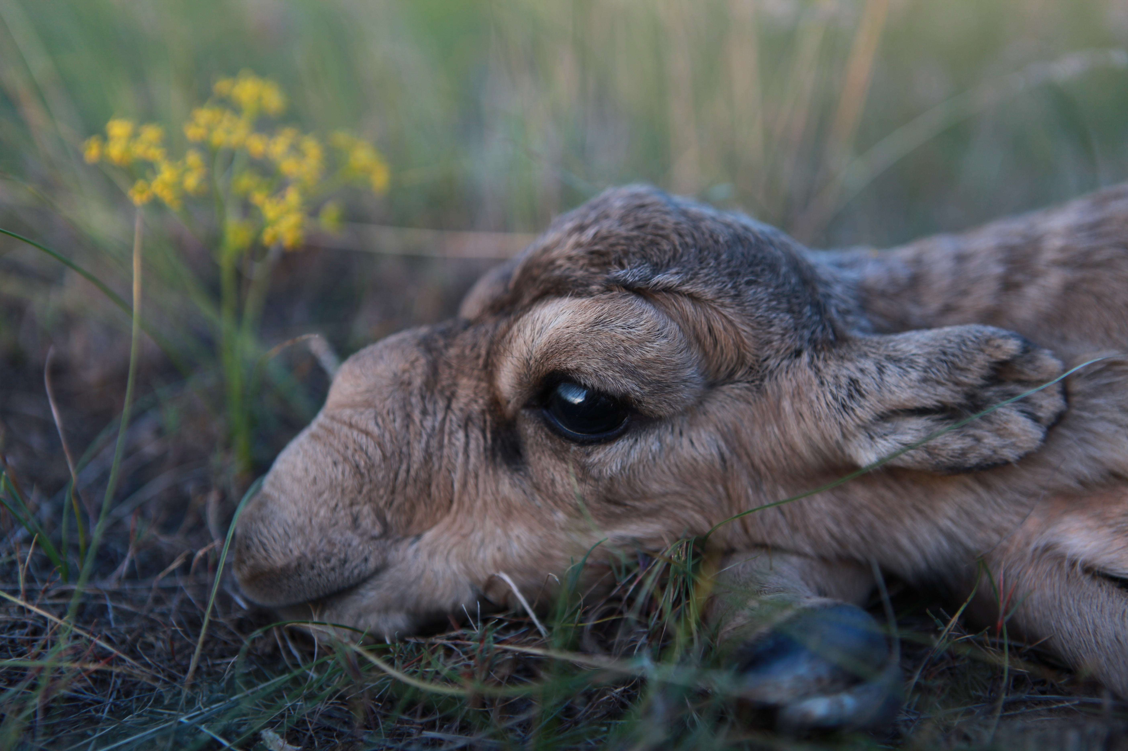
THANK YOU
Insert Image

