Slide 1
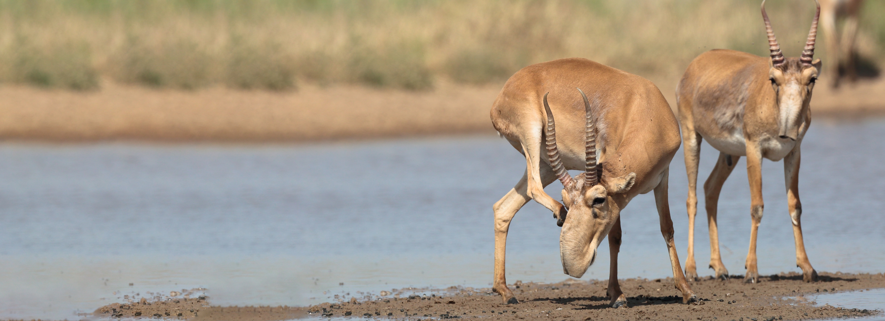


Convention on Migratory Species
The Fifth Meeting of Signatories to the Saiga MOU
12-14 March 2025, Astana, Kazakhstan
Name, position, organization of presenter

Slide 2
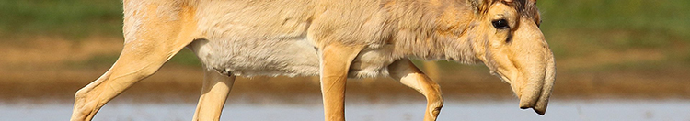
Current data on Saiga populations in [Country Name]

Slide 3
Five main threats for Saiga in [Country Name]

Slide 4

Five key measures to conserve Saiga 2021-2025
Notes:
IOSEA Marine Turtle MOU
Sub regional meetings of the Marine Turtle Task Forces are instrumental in the implementation of the MOU.
Two of the 4 MTTFs met in 2017 and 2018. The report for the NIO is available online
CITES Secretariat in close cooperation with CMS IOSEA secretariat and Advisory Committee compiled and analyzed data on legal and illegal trade international and domestic trade in marine turtles. The process was supported by implementing agencies, such as TRAFFIC and WWF with the financial support from Australia via CMS. The preliminary report is available online
Final report should be available on November 23rd 2018.
Dugong MOU – IKI project
Continuing to revise IKI project based on feedback.
Don’t anticipate any major revisions.
Hope to have submitted to BMU for final approval before the end of this year.

Slide 5
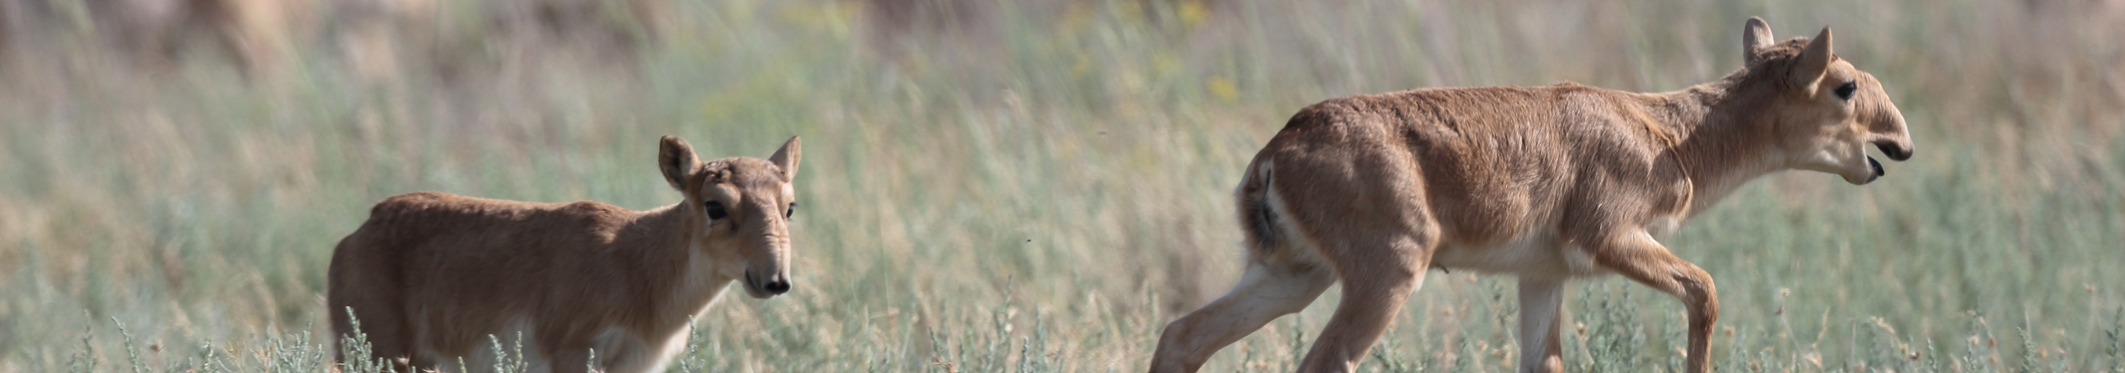
Five key priority measures until 2030

Slide 6
National focal point for Saiga MOU

Slide 7
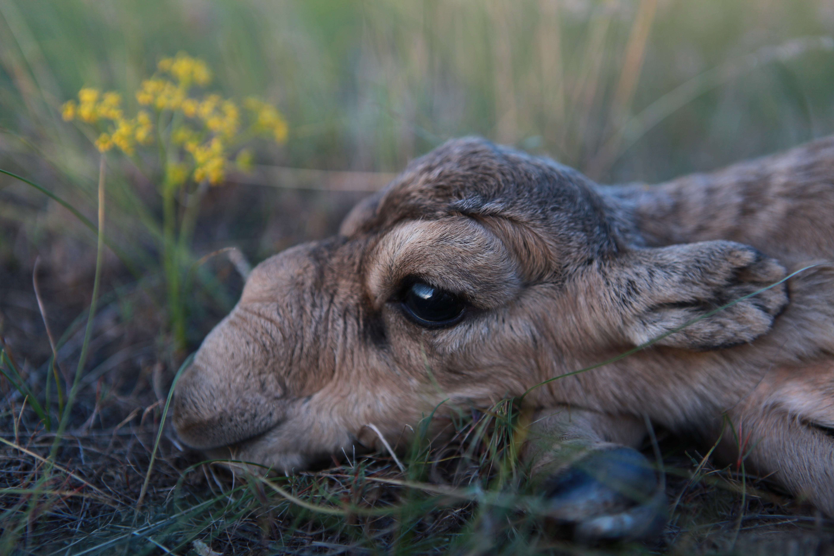
THANK YOU
Insert Image

