Slide 1
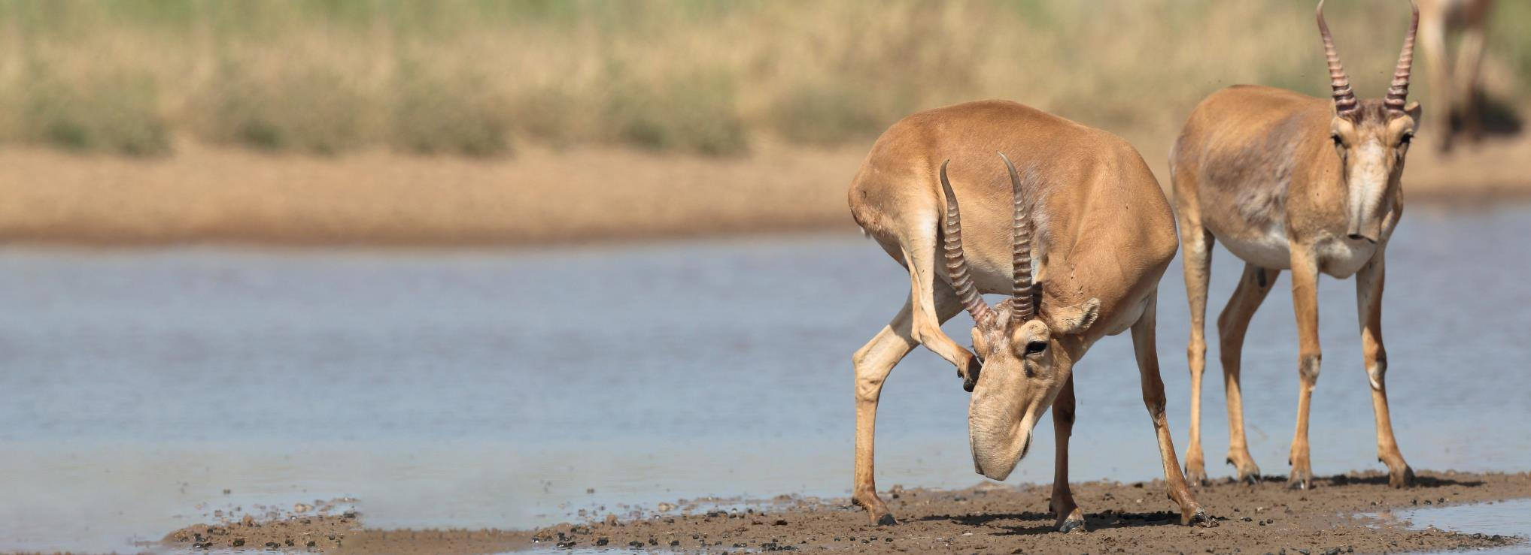


Convention on Migratory Species
The Fifth Meeting of Signatories to the Saiga MOU
12-14 March 2025, Astana, Kazakhstan
Ts. Uranchimeg¹, B. Buuveibaatar², B. Chimeddorj³
¹Ministry of Environment and Climate Change of Mongolia
²Wildlife Conservation Society’s Mongolia Program
³World Wide Fund for Nature’s Mongolia Program Office

Slide 2
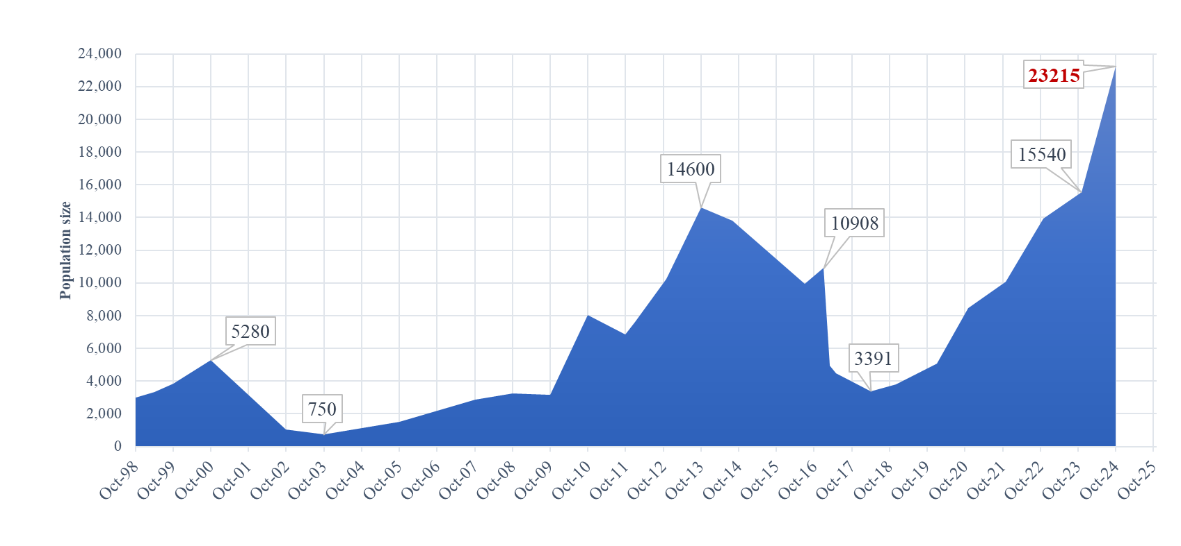
Current data on Saiga populations in Mongolia
Disease outbreak
Harsh winter
Notes:
Despite the absence of a national recording system or database for Saiga, WWF Mongolia has been conducting annual population assessments of the Mongolian saiga antelope, maintaining data since 1998, and providing reports to the government as required.

Slide 3
Five main threats for Saiga in Mongolia
Climate change (extreme events)
Habitat degradation due to livestock grazing
Habitat fragmentation caused by linear infrastructure
Wildlife diseases
Poaching
Notes:
Climate change:
Habitat degradation: overgrazing by livestock, competition with livestock for limited resources especially water points
Habitat fragmentation: There are three paved roads within the saiga's range, with a total length of 306 km. Planned railways, with a length of 205 km, are likely to intersect the saiga's range.
Wildlife disease: The introduction of Peste des Petits Ruminants virus into livestock in Mongolia during 2016–2017 was followed by mass mortality, suggesting that the virus was spilled over from livestock to wildlife among wild ungulates including saiga. FMD outbreak also occurred but less mortality

Slide 4
Five key measures to conserve Saiga 2021-2025
Climate Adaptation: Restoration and protection of 67 natural springs, covering a total area of 31.9 hectares.
Habitat Protection: Establishment of a 91,000-hectare Local Protected Area, with an additional 169,000 hectares proposed for state-level protection.
Anti-Poaching Efforts: SMART patrols conducted by 14 rangers across 46,000 km², with zero recorded poaching cases.
Public Awareness: Covered 60,000 residents within the saiga’s range, 74.7% of whom supported saiga conservation.
Population Monitoring: Annual assessments to track species trends and conservation impact.
Notes:
169,000 ha areas of saiga habtiat was proposed as state PA and ist approval from the parliament is pending
Current law enforcement patrols appear to be successfully protecting saiga. Since the introduction of the SMART patrolling system in 2017, no poaching cases have been reported.
Several initiatives have been undertaken to raise public awareness about the Mongolian saiga. Annually, "Saiga Day" events engage communities, particularly in historic saiga ranges like Uvs province, where the population has recently increased.

Slide 5
Five key priority measures until 2030
Expand the protected area network to cover at least 20% of the saiga’s historic range.
Reinforce small populations and re-establish new ones through natural recovery in suitable sites within the historic range.
Develop early-warning systems for disease outbreaks and secure cross-sectoral support for livestock vaccination policies.
Minimize and mitigate the impacts of new linear infrastructure on saiga habitat and migration routes.
Protect and restore habitats, including water points and pasturelands, to support saiga populations.
Notes:
PAs: By 2024, approximately 33% of the saiga's range is included within protected area networks.

Slide 6
National focal point for Saiga MOU
Ms. Ts. Uranchimeg, Department of Natural Resources Policy and Implementation, Ministry of Environment and Climate Change
Email: uranchimeg@mecc.gov.mn

Slide 7








Recovery of Mongolian saiga

Slide 8
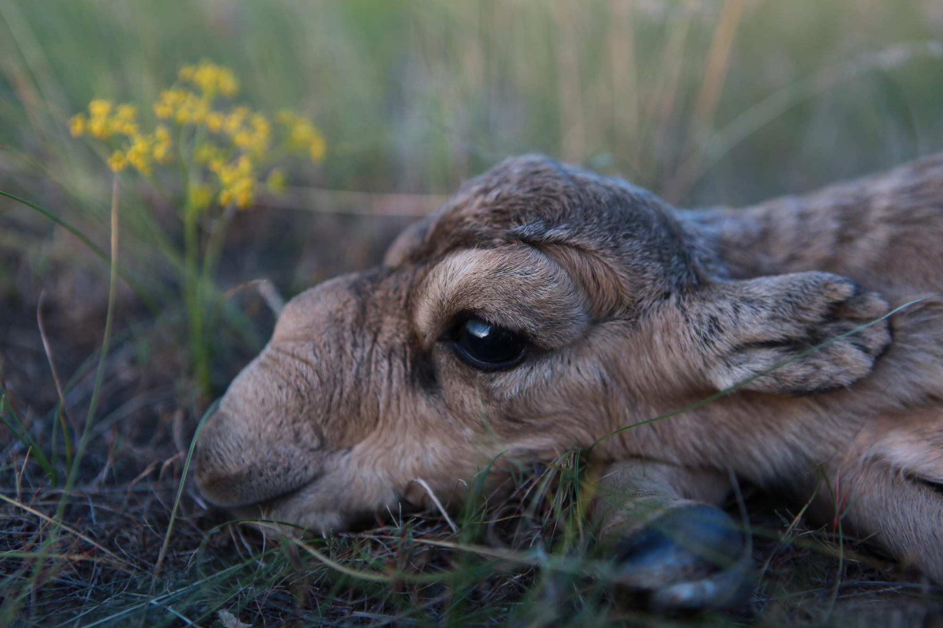
THANK YOU
Insert Image

