Slide 1
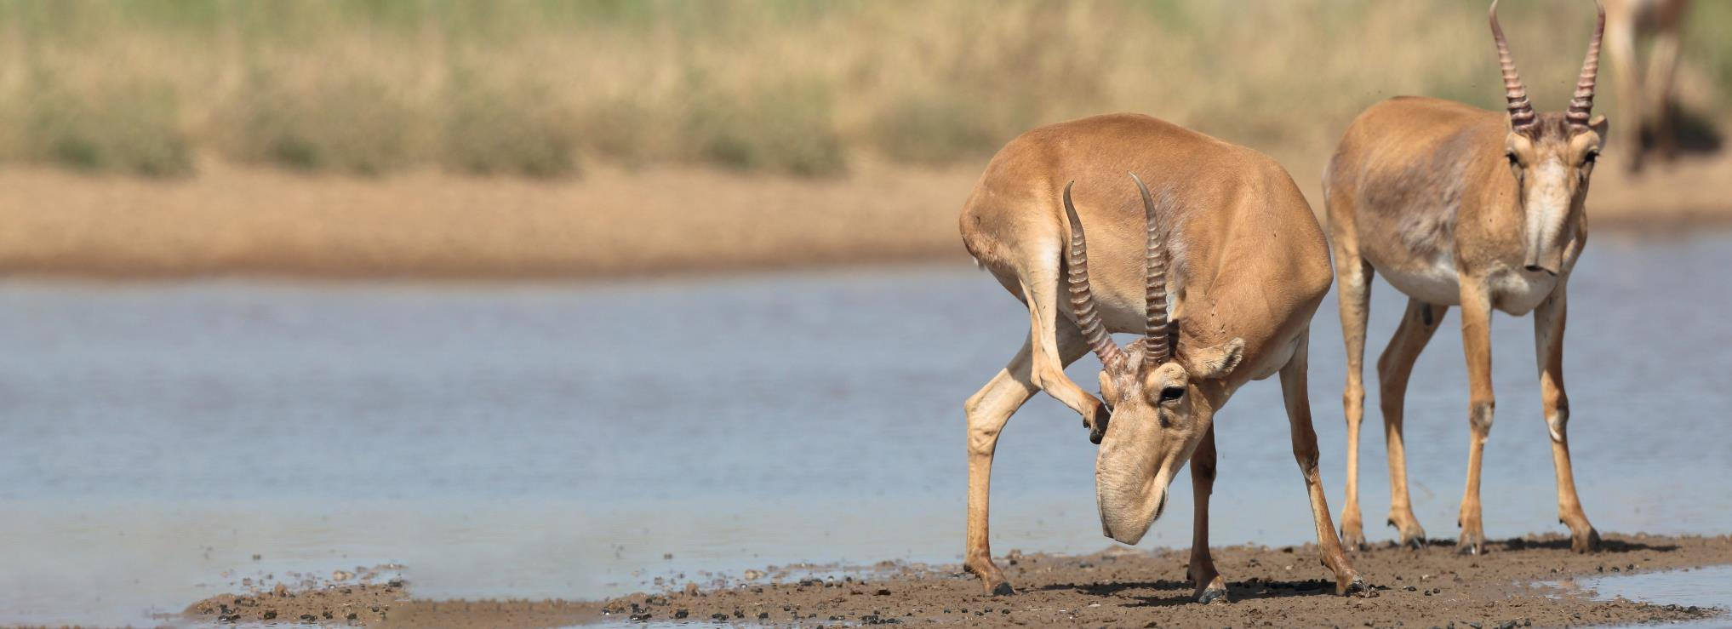


Convention on Migratory Species
The Fifth Meeting of Signatories to the Saiga MOU
12-14 March 2025, Astana, Kazakhstan
Draft Work Programme for the Saiga Antelope 2025-2030
Steffen Zuther, Frankfurt Zoological Society / ACBK

Slide 2
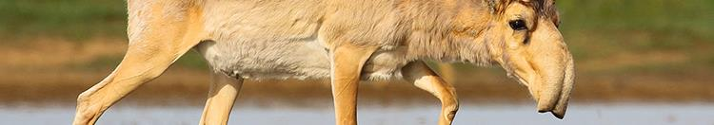
Relevant Decisions by CMS CoP14
CMS CoP14 Decision 14.167 asks CMS Parties to „revise … the CAMI POW for the period 2027-2032, with the aim of streamlining its actions to focus on cross-cutting activities that benefit multiple species…“

Slide 3
Consequences for Saiga Work Programme
Duplications of actions in CAMI Work Programme (among species) need to be removed.
Duplications of actions in CAMI and Saiga Work Programme should be avoided.
Activities, which are part of the CAMI POW, can be removed from Saiga Work Programme.
Activities from previous MTIWP, which are still valid and can be applied to more CAMI species than just Saiga, should be moved to the CAMI POW.
New activities, which can be applied to more CAMI species than just Saiga, should be recommended for inclusion in the CAMI POW.

Slide 4
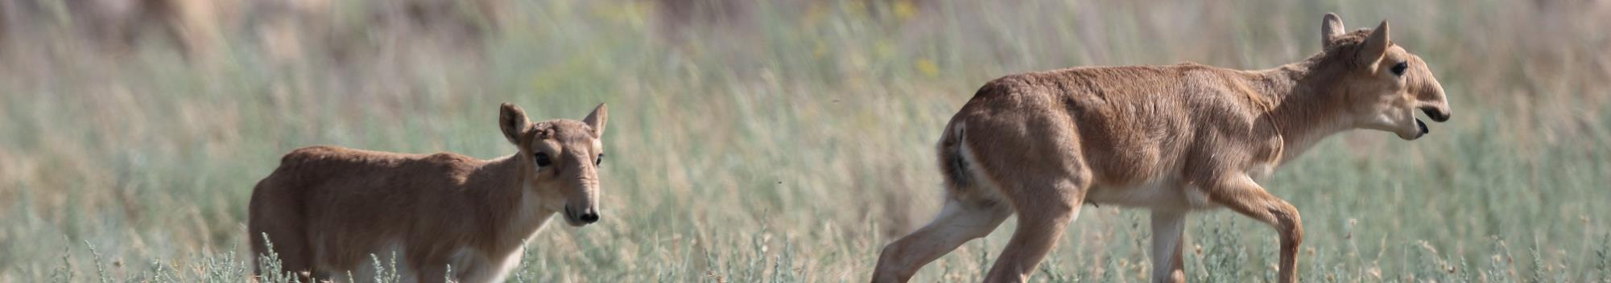
Steps for the development of the Draft Saiga Work Programme
ACBK received task to develop the Draft Work Programme for Saiga 2025-2030.
Experts from Uzbekistan, Mongolia and Russia were asked to provide input for population-specific sections.
Review of initial draft by CMS Secretariat and SCA (EJ Milner-Gulland).
Translation of final draft (ACBK).

Slide 5
Structure of Draft Saiga Work Programme for 2025-2030
Background information
Measures:
  MoU implementation
  Measures addressing several or all populations
    Monitoring
    Land use and human-wildlife conflict
    Connectivity
    Saiga health and diseases
    Education and awareness raising
    Sustainable use and trade
    Captive breeding
  Additional measures for each specific population
    Ustyurt population
    Betpak-Dala population
    Ural population
    Mongolian population
    North-West Pre-Caspian population

Slide 6
Structure of Draft Saiga Work Programme for 2025-2030
Annex 1:
  Range-wide measures taken from the Medium-Term International Work Programme for the Saiga Antelope for 2021-2025 that shall be integrated in the CAMI POW 2026-2032
    Implementation
    Anti-poaching
    Sustainable use and trade
    Work with local people
    Awareness
    Habitat and environmental factors
    Protected areas
    Population monitoring
    Captive breeding
    Health and disease
  Annex 2:
    Measures, which have been proposed in other strategy documents and reports, which could be integrated into the CAMI POW

Slide 7
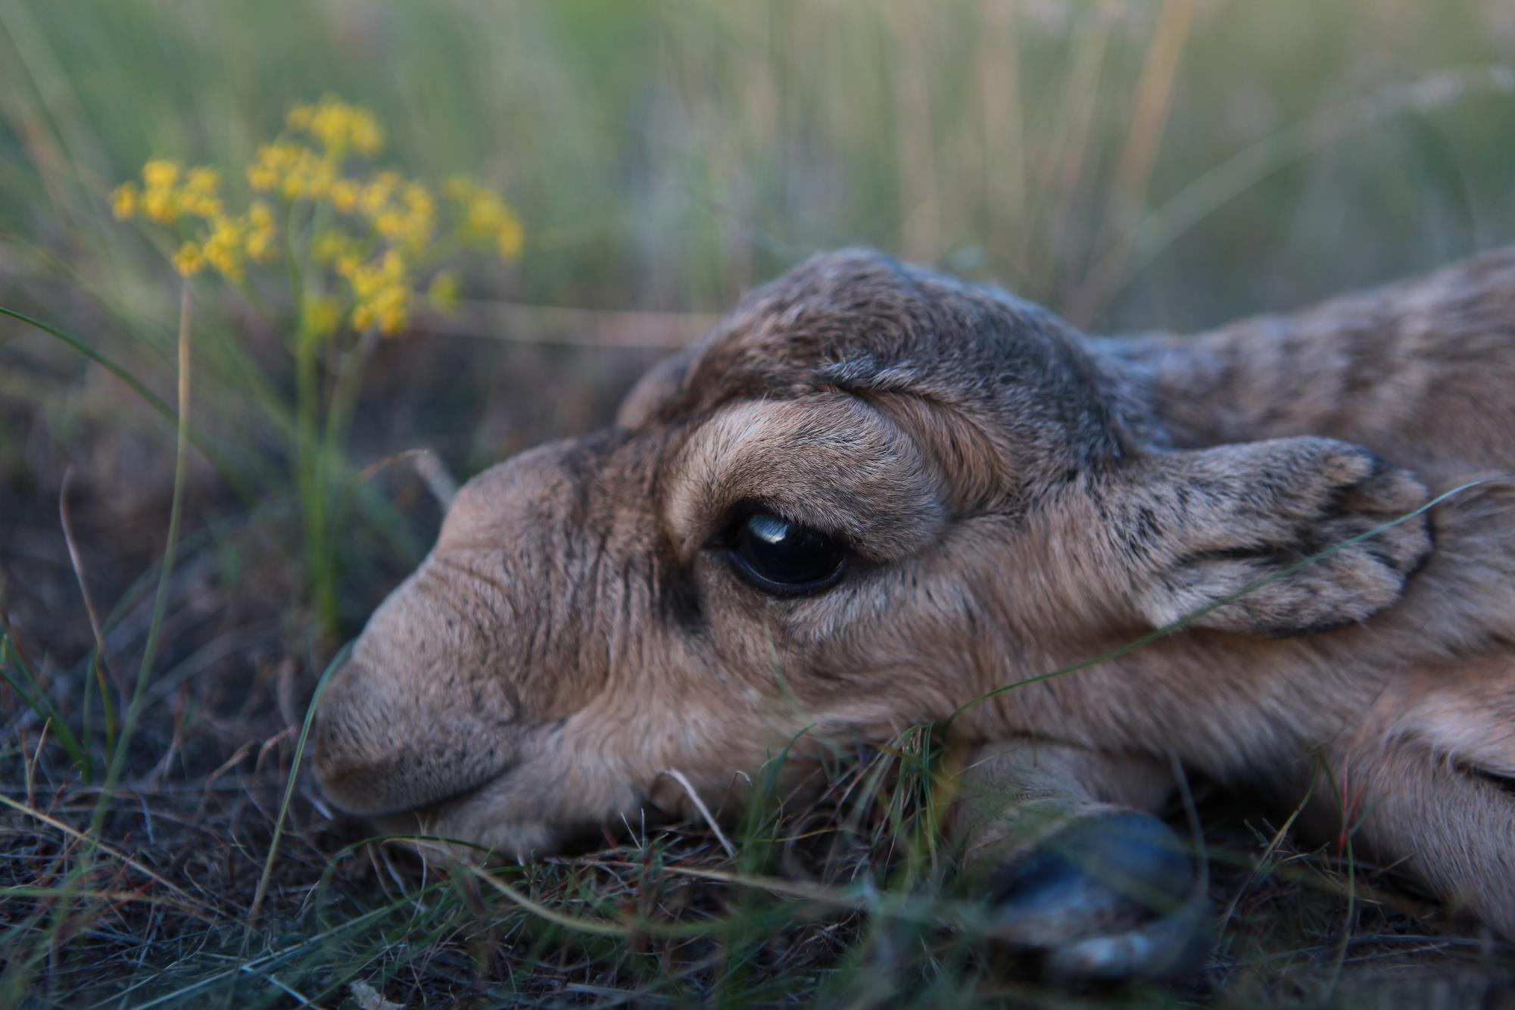
THANK YOU
Спасибо
Insert Image

